Slide 1
Business Intelligence vs. Data Analytics Intro
Damian A. Tamburri, Ph.D.*
* Based on Textbook: Business Intelligence by Carlos Vercellis

Slide 2
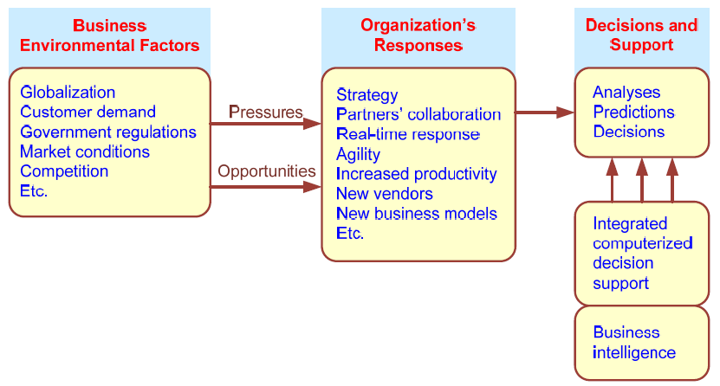
Business Pressures–Responses–Support Model

Slide 3
Organizational Responses
Be Reactive, Anticipative, Adaptive, and Proactive
Managers may take actions, such as
Employ strategic planning
Use new and innovative business models
Restructure business processes
Participate in business alliances
Improve corporate information systems
Improve partnership relationships
Encourage innovation and creativity …cont…>

Slide 4
Closing the Strategy Gap
major objectives of computerized decision support are:
facilitate closing the gap between the current performance of an organization
Elicit its desired performance, as expressed in its mission, objectives, and goals, and the strategy to achieve them
BI means instrumenting informed decision-making.

Slide 5
Closing the Strategy Gap
major objectives of computerized decision support are:
facilitate closing the gap between the current performance of an organization
Elicit its desired performance, as expressed in its mission, objectives, and goals, and the strategy to achieve them
BI means instrumenting informed decision-making.

Slide 6
Managerial Decision Making
Management is a process by which organizational goals are achieved by using resources
Inputs: resources
Output: attainment of goals
Measure of success: outputs / inputs
Management ≅ Decision Making
Decision-making: selecting the best solution from two or more alternatives

Slide 7
Mintzberg's 10 Managerial Roles
Interpersonal
1. Figurehead
2. Leader
3. Liaison
Informational
4. Monitor
5. Disseminator
6. Spokesperson
Decisional
7. Entrepreneur
8. Disturbance handler
9. Resource allocator
10. Negotiator

Slide 8
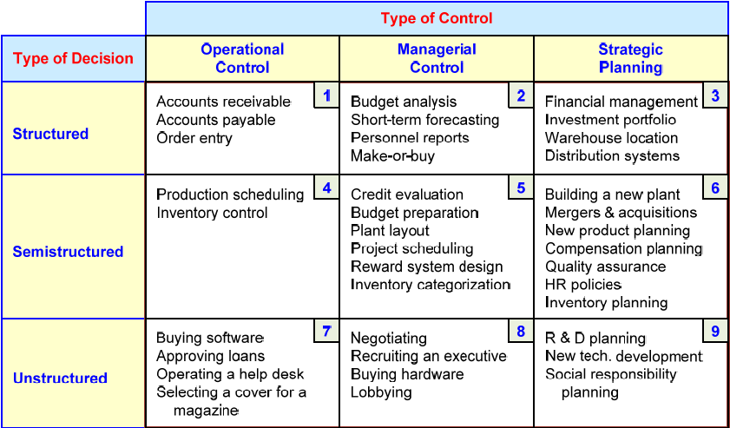
A Decision Support Framework (by Gory and Scott-Morten, 1971)

Slide 9
A Decision Support Framework – cont.
Degree of Structuredness (Simon, 1977)
Decision are classified as
Highly structured (a.k.a. programmed)
Semi-structured
Highly unstructured (i.e., non-programmed)
Types of Control (Anthony, 1965)
Strategic planning (top-level, long-range)
Management control (tactical planning)
Operational control

Slide 10
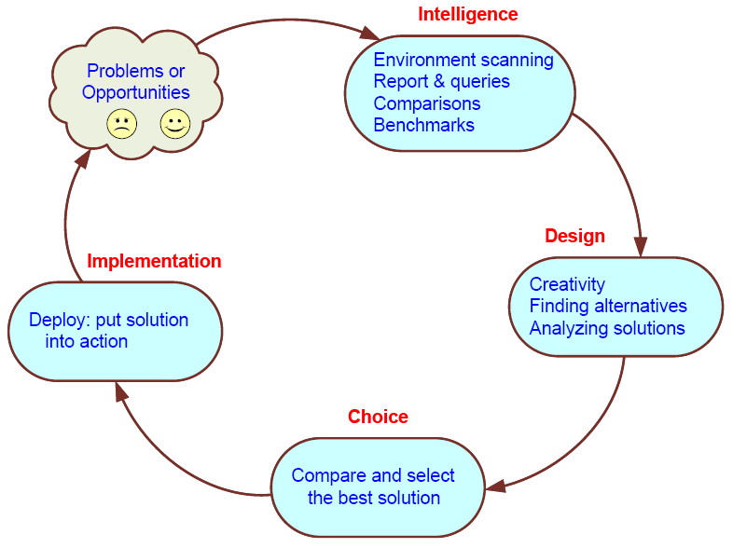
Simon’s Decision-Making Process

Slide 11
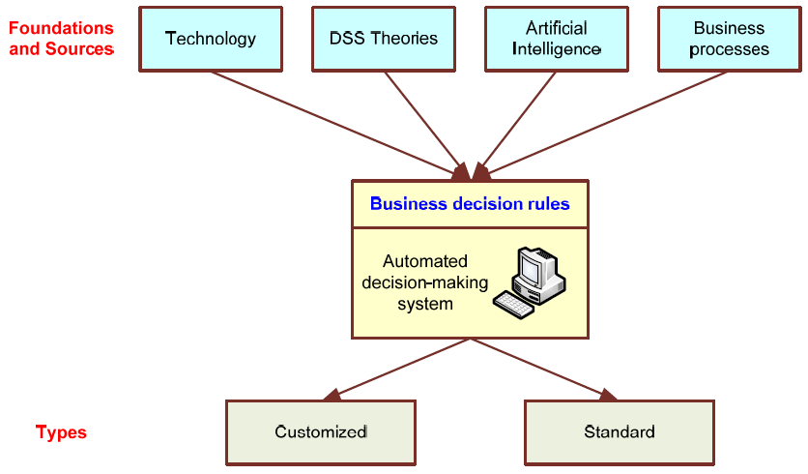
Automated Decision-Making Framework

Slide 12
Concept of Decision Support Systems
Classical Definitions of DSS
Interactive computer-based systems, which help decision makers utilize data and models to solve unstructured problems" - Gorry and Scott-Morton, 1971
Decision support systems couple the intellectual resources of individuals with the capabilities of the computer to improve the quality of decisions. It is a computer-based support system for management decision makers who deal with semistructured problems - Keen and Scott-Morton, 1978

Slide 13
DSS as an Umbrella Term
The term DSS can be used as an umbrella term to describe any computerized system that supports decision making in an organization
E.g., an organization wide knowledge management system; a decision support system specific to an organizational function (marketing, finance, accounting, manufacturing, planning, SCM, etc.)

Slide 14
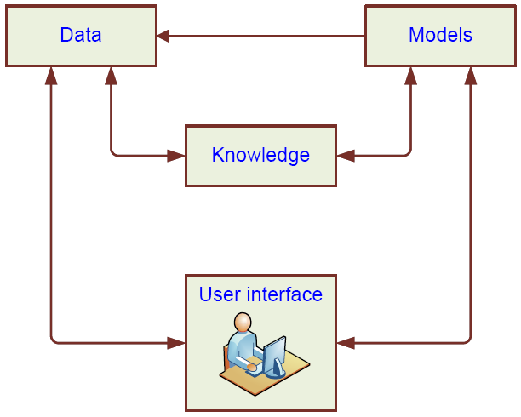
High-Level Architecture of a DSS

Slide 15
Types of DSS
Two major types
Model-oriented DSS
Data-oriented DSS
Evolution of DSS into Business Intelligence
Use of DSS moved from specialist to managers, and then whomever, whenever, wherever
Enabling tools like OLAP, data warehousing, data mining, intelligent systems, delivered via Web technology have collectively led to the term “business intelligence” (BI) and “business analytics”

Slide 16
Again: Business Intelligence (BI)
BI is an umbrella term that combines architectures, tools, databases, analytical tools, applications, and methodologies
Like DSS, BI a content-free expression, so it means different things to different people
BI's major objective is to enable easy access to data (and models) to provide business managers with the ability to conduct analysis
BI helps transform data, to information (and knowledge), to decisions and finally to action

Slide 17
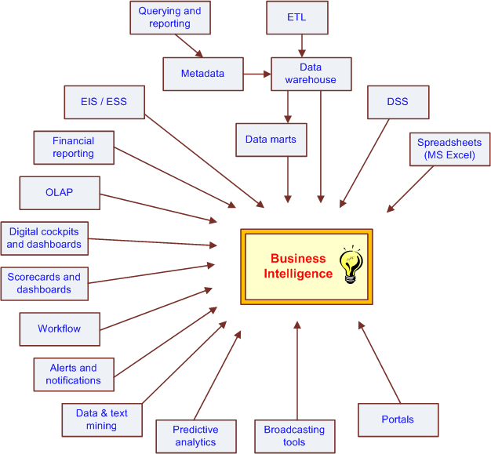
The Evolution of BI Capabilities

Slide 18
The Architecture of BI
A BI system has four major components
a data warehouse, with its source data
business analytics, a collection of tools for manipulating, mining, and analyzing the data in the data warehouse;
business performance management (BPM) for monitoring and analyzing performance
a user interface (e.g., dashboard)

Slide 19
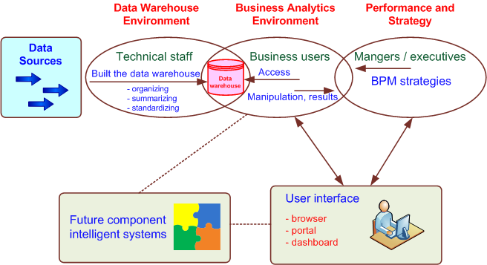
A High-Level Architecture of BI

Slide 20
Components in a BI Architecture
The data warehouse is a large repository of well-organized historical data
Business analytics are the tools that allow transformation of data into information and knowledge
Business performance management (BPM) allows monitoring, measuring, and comparing key performance indicators
User interface (e.g., dashboards) allows access and easy manipulation of other BI components

Slide 21
Styles of BI
MicroStrategy, Corp. distinguishes five styles of BI and offers tools for each
report delivery and alerting
enterprise reporting (using dashboards and scorecards)
cube analysis (also known as slice-and-dice analysis)
ad-hoc queries
statistics and data mining

Slide 22
The Benefits of BI
The ability to provide accurate information when needed, including a real-time view of the corporate performance and its parts
A survey by Thompson (2004)
Faster, more accurate reporting (81%)
Improved decision making (78%)
Improved customer service (56%)
Increased revenue (49%)
See Table 1.3 for a list of BI analytic applications, the business questions they answer and the business value they bring

Slide 23
Implementing BI-type systems

Slide 24
Business Intelligence Architectures
Data Sources
Gather and integrate data
Challenges
Data Warehouses and Data Marts
Extract, transform and load data
Multidimensional Exploratory Analysis
Data Mining and Data Analytics
Extraction of Information and Knowledge from Data
Build Models of Prediction
An example
Building a telecom customer retention model
Given a customer’s telecom behavior, predict if the customer will stay or leave
KDD CUP 2020 Data

Slide 25
Data Warehousing
Data warehouse:
Repository for the data available for BI and Decision Support Systems
Internal Data, external Data and Personal Data
Internal data:
Back office: transactional records, orders, invoices, etc.
Front office: call center, sales office, marketing campaigns,
Web-based: sales transactions on e-commerce websites
External:
Market surveys, GIS systems
Personal: data about individuals
Meta: data about a whole data set, systems, etc. E.g., what structure is used in the data warehouse? The number of records in a data table, etc.
Data marts: subset of data warehouse for one function (e.g., marketing).
OLAP: set of tools that perform BI analysis and decision making.
OLTP: transactional related online tools, focusing on dynamic data.

Slide 26
Working with Data
Let’s first consider an example dataset
Univariate Analysis (7.1)
Histograms
Empirical density=e_h/m, e_h=values that belong to class h.
X-axis=value range
Y-axis=empirical density
Independent Variables |  |  |  | Dependent Variable
Outlook | Temp | Humidity | Windy | Play
sunny | 85 | 85 | FALSE | no
sunny | 80 | 90 | TRUE | no
overcast | 83 | 86 | FALSE | yes
rainy | 70 | 96 | FALSE | yes
rainy | 68 | 80 | FALSE | yes
rainy | 65 | 70 | TRUE | no
overcast | 64 | 65 | TRUE | yes
sunny | 72 | 95 | FALSE | no
sunny | 69 | 70 | FALSE | yes
rainy | 75 | 80 | FALSE | yes
sunny | 75 | 70 | TRUE | yes
overcast | 72 | 90 | TRUE | yes
overcast | 81 | 75 | FALSE | yes
rainy | 71 | 91 | TRUE | no

Slide 27
Measures of Dispersion
Variance
Standard deviation
Normal Distribution: interval
r=1 contains approximately 68% of the observed values;
r=2: 95% of the observed values
r=3: 100% of values
Thus, if a sample outside ( ), it may be an outlier
Thm. Chebyshev’s Theorem
r>=1, and (x1, x2, …xm)
be a group of m values.
(1-1/r²) of the values will fall
within interval
Notes:
Chebyshev's theorem: It is an estimation of the minimum proportion of observations that will fall within a specified number of standard deviations (k), where k>1. Data: Data is a set of numerical figures representing the results of a measurement, from which inferences can be created.

Slide 28
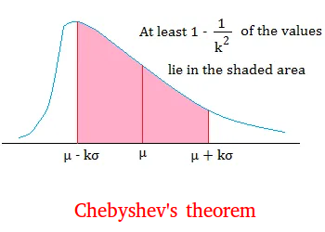
Notes:
Chebyshev's theorem states that a certain proportion of any data set must fall within a particular range around the central mean value which is determined by the standard deviation of the data.

Slide 29
Heterogeneity Measures
The Gini index (Wiki: The Gini coefficient (also known as the Gini index or Gini ratio) is a measure of statistical dispersion developed by the Italian statistician and sociologist Corrado Gini and published in his 1912 paper "Variability and Mutability" (Italian: Variabilità e mutabilità) )
Let f_{h} be the frequency of class h; then G is Gini index
Entropy E: 0 means lowest heterogeneity, and 1 highest.

Slide 30
Test of Significance
Given two models:
Model M1: F-measure = 85%, tested on 30 instances
Model M2: F-measure = 75%, tested on 5000 instances
Can we say M1 is better than M2?
How much confidence can we place on accuracy of M1 and M2?
Can the difference in performance measure be explained because of random fluctuations in the test set?

Slide 31
Confidence Intervals
Given a frequency of (f) is 25%. How close is this to the true probability p?
Prediction is just like tossing a biased coin
“Head” is a “success”, “tail” is an “error”
In statistics, a succession of independent events like this is called a Bernoulli process
Statistical theory provides us with confidence intervals for the true underlying proportion!
Mean and variance for a Bernoulli trial with success probability p: p, p(1-p)
Notes:
31

Slide 32
Confidence intervals
We can say: p lies within a certain specified interval with a certain specified confidence
Example: S=750 successes in N=1000 trials
Estimated success rate: f=75%
How close is this to true success rate p?
Answer: with 80% confidence p∈[73.2,76.7]
Another example: S=75 and N=100
Estimated success rate: 75%
With 80% confidence p∈[69.1,80.1]
Notes:
32

Slide 33
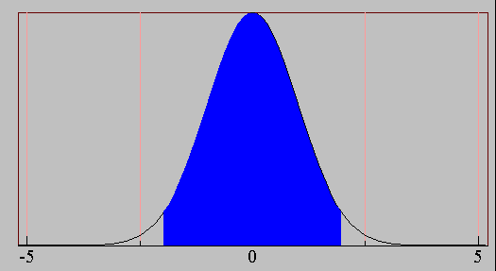
Confidence Interval for Normal Distribution
For large enough N, p follows a normal distribution
p can be modeled with a random variable X:
c% confidence interval [-z ≤ X ≤ z] for random variable X with 0 mean is given by:
c=Area = 1 - α
-Z_{α/2}
Z_{1- α /2}
Notes:
33

Slide 34
Transforming f
Transformed value for f:
(i.e. subtract the mean and divide by the standard deviation)
Resulting equation:
Solving for p:
Notes:
34

Slide 35
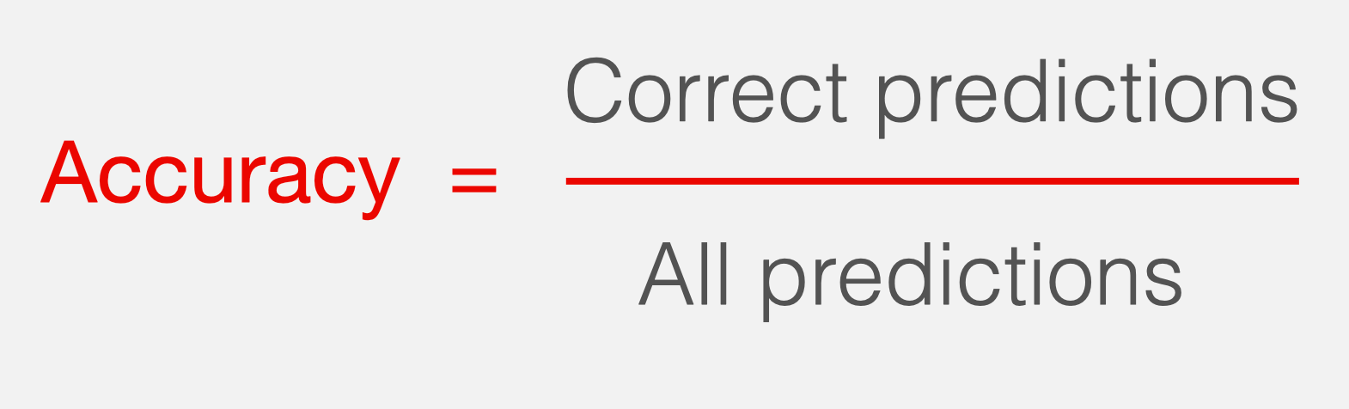
Confidence Interval for Accuracy
1-α | Z
0.99 | 2.58
0.98 | 2.33
0.95 | 1.96
0.90 | 1.65
N | 50 | 100 | 500 | 1000 | 5000
p(lower) | 0.670 | 0.711 | 0.763 | 0.774 | 0.789
p(upper) | 0.888 | 0.866 | 0.833 | 0.824 | 0.811
Consider a model that produces an accuracy of 80% when evaluated on 100 test instances:
N=100, acc = 0.8
Let 1-α = 0.95 (95% confidence)
From probability table, Z_{α/2}=1.96

Slide 36
Confidence limits
Pr[X≥z] | z
0.1% | 3.09
0.5% | 2.58
1% | 2.33
5% | 1.65
10% | 1.28
20% | 0.84
40% | 0.25
Confidence limits for the normal distribution with 0 mean and a variance of 1:
Thus:
To use this, We have to reduce our random variable p to have 0 mean and unit variance
Notes:
36

Slide 37
Examples
f=75%, N=1000, c=80% (so that z=1.28):
f=75%, N=100, c=80% (so that z=1.28):
Note that normal distribution assumption is only valid for large N (i.e. N > 100)
f=75%, N=10, c=80% (so that z=1.28):
Notes:
37

Slide 38
Implications
First, the more test data the better
N is large, thus confidence level is large
Second, when having limited training data, how do we ensure many test data?
Thus, cross validation, since we can then make all training data to participate in the test.
Third, which model are testing?
Each fold in an N-fold cross validation is testing a different model!
We wish this model to be close to the one trained with the whole data set
Thus, it is a balancing act: # folds in a CV cannot be too large, or too small.

Slide 39

Cross Validation: Holdout Method
Break up data into groups of the same size
Hold aside one group for testing and use the rest to build model
Repeat
iteration
Test
Notes:
39

Slide 40
Summarizing: Cross Validation in BI
Natural performance measure for BI classification problems: error rate
#Success: instance’s class is predicted correctly
#Error: instance’s class is predicted incorrectly
Error rate: proportion of errors made over the whole set of instances
Training Error vs. Test Error
Confusion Matrix, to test with business
Confidence
2% error in 100 tests
2% error in 10000 tests
Which one do you trust more?
Apply the confidence interval idea…
Tradeoff:
# of Folds = # of Data N
Leave One Out CV
Trained model very close to final model, but test data = very biased
# of Folds = 2
Trained Model very unlike final model, but test data = close to training distribution
Notes:
40

Slide 41
ROC (Receiver Operating Characteristic)
Page 298 of TSK book.
Many applications care about ranking (give a queue from the most likely to the least likely)
Examples…
Which ranking order is better?
ROC: Developed in 1950s for signal detection theory to analyze noisy signals
Characterize the trade-off between positive hits and false alarms
ROC curve plots TP (on the y-axis) against FP (on the x-axis)
Performance of each classifier represented as a point on the ROC curve
changing the threshold of algorithm, sample distribution or cost matrix changes the location of the point

Slide 42
Metrics for Performance Evaluation…
 | PREDICTED CLASS
ACTUAL CLASS |  | Class=Yes | Class=No
 | Class=Yes | a (TP) | b (FN)
 | Class=No | c (FP) | d (TN)
Widely-used metric:

Slide 43
How to Construct an ROC curve
Use classifier that produces posterior probability for each test instance P(+|A) for instance A
Sort the instances according to P(+|A) in decreasing order
Apply threshold at each unique value of P(+|A)
Count the number of TP, FP, TN, FN at each threshold
TP rate, TPR = TP/(TP+FN)
FP rate, FPR = FP/(FP + TN)
Instance | P(+|A) | True Class
1 | 0.95 | +
2 | 0.93 | +
3 | 0.87 | -
4 | 0.85 | -
5 | 0.85 | -
6 | 0.85 | +
7 | 0.76 | -
8 | 0.53 | +
9 | 0.43 | -
10 | 0.25 | +
Predicted by classifier
This is the ground truth

Slide 44
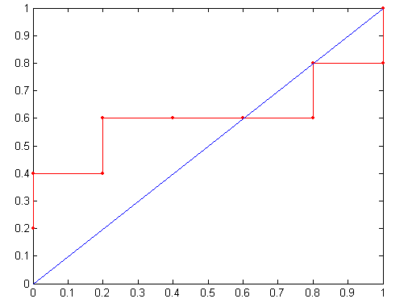
How to construct an ROC curve
Threshold >=
ROC Curve:

Slide 45
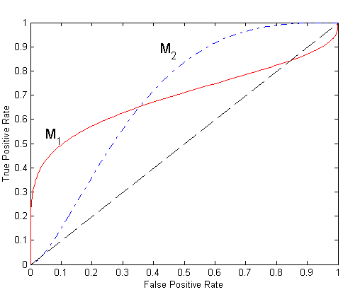
Using ROC for Model Comparison
No model consistently outperform the other
M₁ is better for small FPR
M₂ is better for large FPR
Area Under the ROC curve: AUC
Ideal:
Area = 1
Random guess:
Area = 0.5

Slide 46
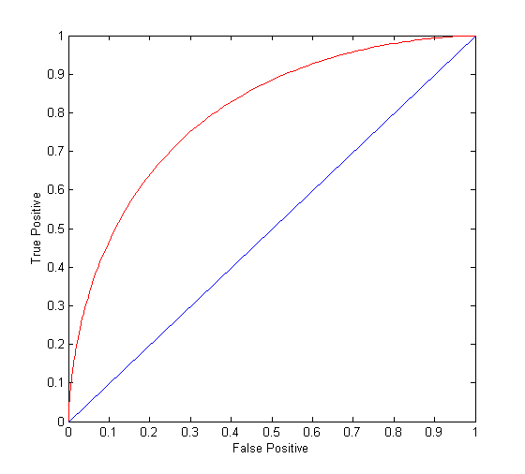
Area Under the ROC Curve (AUC)
(TP,FP):
(0,0): declare everything to be negative class
(1,1): declare everything to be positive class
(1,0): ideal
Diagonal line:
Random guessing
Below diagonal line:
prediction is opposite of the true class

Slide 47
Service-oriented Business Intelligence (SoBI)*
* Tailored from MSDN

Slide 48
About SoBI
Synergy (n): the working together of two things to produce an effect greater than the sum of their individual effects.
SoBI is the synergy of the Business Intelligence and Service Orientation paradigms
We define a framework in which both architectures can exist in harmony and leverage the benefits of the other.
We have identified guiding principles to ensure that the fundamental tenets of each of the component architectures are not violated.

Slide 49
Overview Service Orientation (SO)
Service Orientation is an approach to building distributed applications
Services expose capabilities through interfaces
Interfaces exchange messages
Schemas maintain message & data standards
Encapsulates functionality and provides abstraction
We are talking services, not just web services (HTTP)
Service Orientation is the a good approach to building agile and flexible applications and a good application-level integration strategy

Slide 50
Overview BI (including Data Warehousing)
Data Gathering - Extract, Transform and Load (ETL)
Data Storage - Data Warehouse (EDW)
Data Presentation (The BI bit)
OLAP
Reporting
DB
ETL
Reporting
Services
DB
Staging SQL Server
Warehouse SQL Server
DB
Analysis
Services
DB
Error / Audit / Metadata
Flow of Data

Slide 51
Why did SoBI happen?
Customer projects driving similarities in EAI / ETL
Conceptually
Architecturally
Vendor landscape is changing
Analysts talking about convergence
Real project
Looks like a BI project
Client wants Service Orientation

Slide 52
The Views of SO and BI
From an SO perspective, BI is seen as a collection of services
Data Publication Services (BI)
Transformation & other BI services
From a BI perspective, SO is seen as a collection of data sources
SO
BI
BI Seen as a Collection of Services
SO Services Seen as Data Sources
Disciplines to support SO
Architectural overlap
Disciplines to support BI

Slide 53
Different Challenges
SO
Small messages on demand
Transformations tend to be simple
BI
Infrequent exchanges of (large) amounts of data
Transformations complex
Increasing drive for Real Time DW
SoBI
Leverages the strengths at the extremes
Exploits the middle ground
SO
BI
Message Volume
Message Size
Small Grain Services / Real-time events
Medium Grain Services
Large Grain Data Import / Export / ETL
Messages vs. Data

Slide 54
Summary (Core Strengths)
Service Orientation | Business Intelligence
Provides application-to-application integration
Well suited to events and real-time data – high frequency
Allows agile change in business processes
Supports reuse of enterprise components
Encapsulates and abstracts functionality
Tightly defined data formats and structures
Well suited for data-to-data integration
Can handle large data volumes
Provides foundation for business decisions
Provides a combined model of the enterprise data
Good tools and mechanisms for transforming data
Ability to question the data and to answer key business questions

Slide 55
SoBI Wins
Provides a logical model of enterprise data which can be exploited by SO
Ability to reuse transformation logic usually hidden in ETL
Brings interface abstraction patterns to BI
Provides road map for integration
Driving improvements in enterprise data quality
Expose Reference Data to other Services & Systems

Slide 56
SoBI
An Architectural Pattern …
Notes:
56

Slide 57
SoBI Vision
Provide best practice implementation framework
To integrate at the most appropriate architectural level
To provide the data modelling of a BI project within the Service Orientation strategy of leaving the source systems in place
Provide a common implementation for data transformations and data logic:
Data to Data
Data to Service
Service to Data
Service to Service

Slide 58
SoBI Principles (1)
Accept a SO Strategy
There is a strategic plan for Service Orientation
Data Modelling
Build a reference model of the enterprise data
Data Ownership
System of Record owns data
The system (and service) owns the external representation
DW owns Business Intelligence and reference data
System of Record data to be held in Enterprise stores or applications

Slide 59
SoBI Principles (2)
Governance
Enforce System of Record
Clear Links into Enterprise Architecture Data Model
Define Processes
e.g. selection of messaging standards
Application Citizenship
Change Management Process

Slide 60
Guidance Data Warehouse
It is:
The single version of the truth for BI data
It will:
Provide open access to data services
Support ad hoc analysis
Support ‘pre-canned’ management reporting
Consolidate data from disparate source systems
Externalise Reference Data
It will not:
Become a ‘dumping ground’ for all data
Become the data owner
Be the default data source to other applications

Slide 61
Guidance Service Orientation
It is:
The architectural approach for application integration
It will:
Provide application-to-application integration
Provide some event feeds to the DW
Describe the services provided and the messages passed
Provide the infrastructure services for all applications
It will not:
Be used in every circumstance
Replace data import interfaces (in all cases)

Slide 62
SoBI
An Actual Example …
Notes:
62

Slide 63
Project Background
Oil and Gas Company
Upstream Division (Exploration and Production)
Complex App Landscape
Many application silos
No integration or integration strategy
Many unstructured data sources (mostly Excel)
Don’t Want Another Data Silo
This is not a green-field one schema, one database project
Want a Better Future
Is essential that we build a better foundation for the future
Need a global architectural platform for all new integration projects
Case Study Coming Soon …
Notes:
63

Slide 64
Technology Stack
.NET FX 2.0
Visual Studio 2005 Team Suite
Visual Studio 2005 Team System
Conchango’s SCRUM for Team System
SQL Server 2005
RDBMS
Analysis Services
Integration Services
Reporting Services
Microsoft Office Business Scorecard Manager 2005
Windows SharePoint Services 2.0
Supporting products
Enterprise Library 2.0
WSE 3.0

Slide 65
SoBI Patterns Overview
Have identified a number of patterns
Patterns will be used to prescribe the solution in a given scenario
Including real world exceptions to the principles
Grouped by:
System Types
E.g. Batch processing, Real-Time
System Constraints
E.g. Processing windows, high data volumes

Slide 66
BI Transformations and SoBI
ETL Challenge | Example
Data Cleansing | Product with Invalid Department
Referential Integrity | Sales for ‘Non Existent’ Products (Inferred Members)
Timeliness of Data | Data Warehouse Is Always Out of Date
Expose complex business rules usually buried in the ETL layer Surface warehouse ETL functionality to SoBI Obtain a cross-system-consistent view of Product

Slide 67
BI Transformations and SoBI
ETL Transform | Example
Calculation | Variance = (SAP.Actuals-Excel.Forecasts) * 100 SAP.Actuals
Aggregation | 1 million EPOS Transactions/day 3 years history = 1 billion records
Surface warehouse ETL functionality to SoBI Enables real-time feeds into the data warehouse Service can provide aggregations of the position ‘now’ Better mechanism for invoking batch ETL Hybrid approach to managing deltas in real-time DW

Slide 68
BI Transformations and SoBI
ETL Transform | Example
Data Consolidation | SAP.ProductID=A1234 Supplier.ProductID=X3
Data Validation | 99/99/9999 changed to NULL in DW
Mappings available as service EAI implementation could use this service Enterprise reference, we have done the hard work in the ETL Single validation service

Slide 69
BI Transformations and SoBI
ETL Transform | Example
Slowly Changing Dimension | EmployeeSK=1, Employee=Jeffrey Adams, Region=South, CurrentFlag=0, ValidFrom=01-Jan-05, ValidTo=08-May-05 EmployeeSk=2, Employee=Jeffrey Adams, Region=North, CurrentFlag=1, ValidFrom=08-May-05, ValidTo=NULL
Historical Data | SoR – 6 months data DW – 3 years data
Compliance / Audit Build a rich service – e.g. fraud Aggregation of transactional and historical data a service

Slide 70
Summary
SoBI is the mixing of approaches from Service Orientation and Business Intelligence
It attempts to solve real word problems of integration in an Enterprise of disparate ‘stove piped’ systems
It attempts to provide for Operational and MIS data
It attempts to provide a road map for better class integration
It attempts to provide a common data transformation mechanism
It sets out guidance in the form of principles and patterns

Slide 71
Conclusions
BI is more than a neat theoretical exercise
BI can help deal with immediate Integration challenges
BI provides an architectural platform for change
As an adopted strategy, SoBI can help in determining the definitive source of data and true ownership

Slide 72

Questions?
Notes:
72

Slide 73
Other Sources
Tan, Steinbach, Kumar (TSK) Book:
Introduction to Data Mining
Weka Book: Witten and Frank (WF):
Data Mining
Han and Kamber (HK Book):
Data Mining
BI Book is denoted as “BI Chapter #...”

